Slide 1
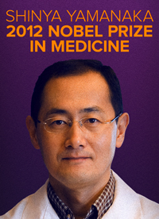
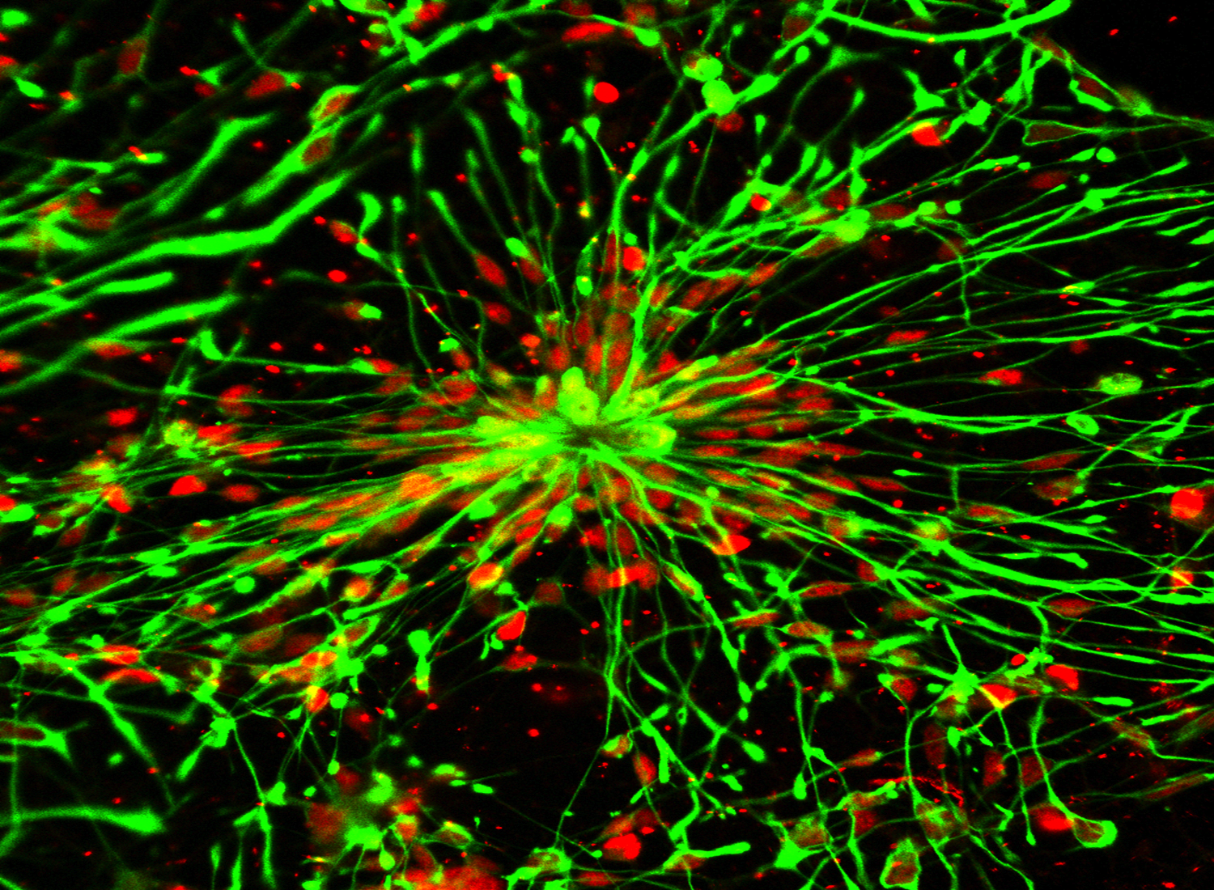
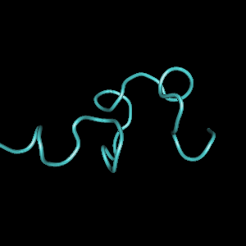
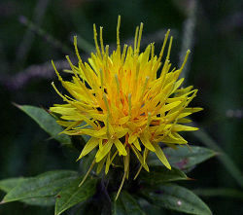
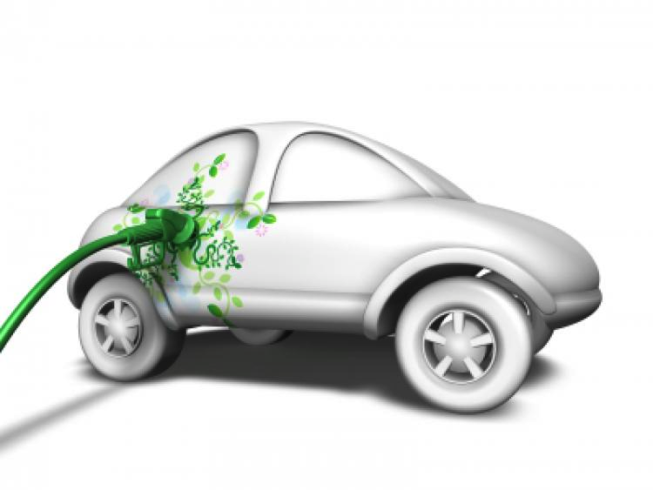
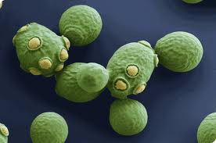
Intro to Biotech
Lect.9
Biotechnology

Slide 2
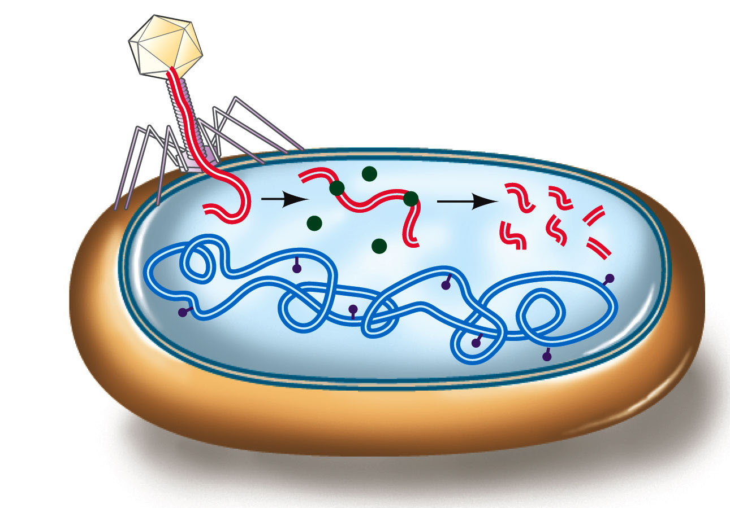
Intro to Biotech
Lect.9
Recombinant DNA & Biotechnology
How is DNA manipulated?
• isolate DNA (from…)
- properties of
- properties of
• digest DNA
-
-
• discovery = natural defense
mechanism
• methylation sensitivity (Why?)
• recognition sequences =
• palindromic:

Slide 3
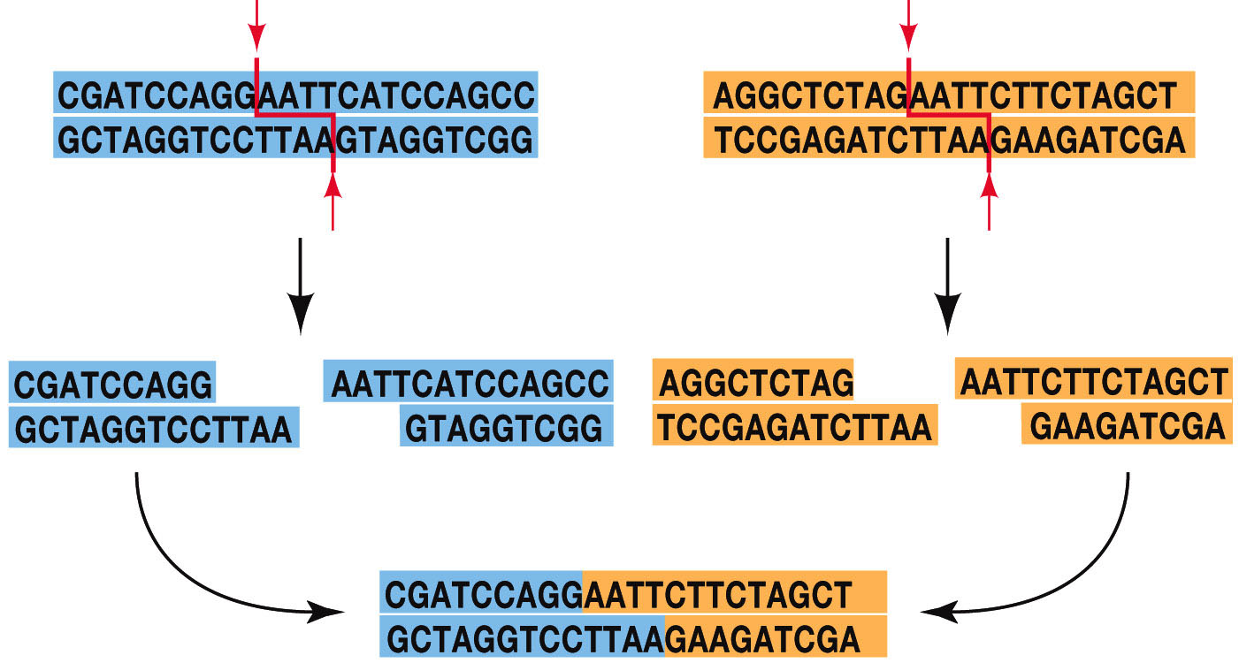
Intro to Biotech
Lect.9
Recombinant DNA & Biotechnology
How is DNA manipulated?
• staggered vs blunt
• directed vs undirected

Slide 4
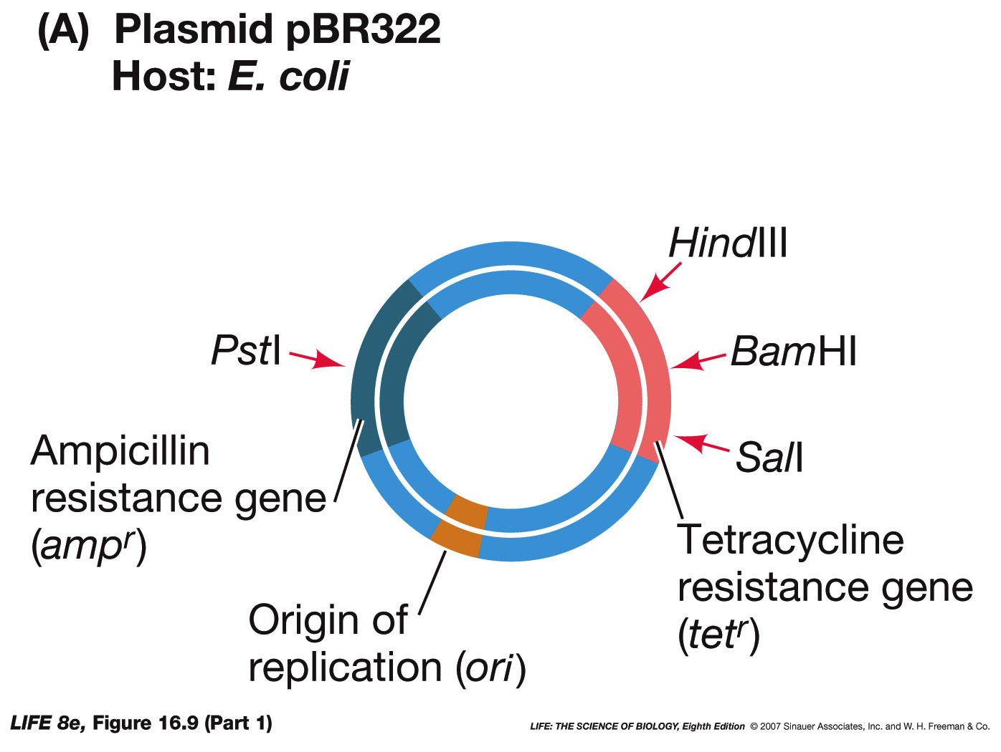
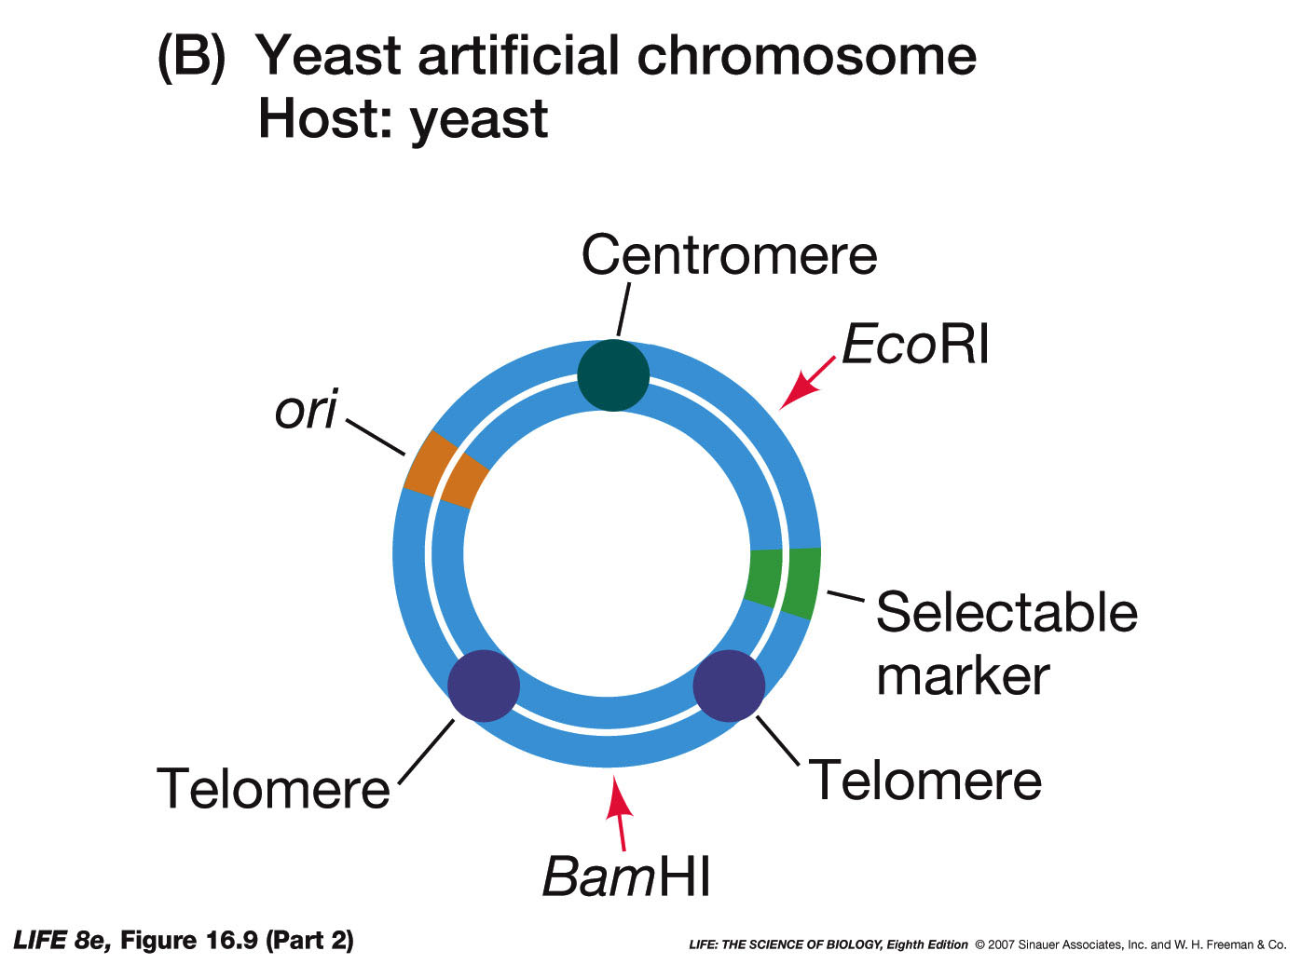
Intro to Biotech
Lect.9
Recombinant DNA & Biotechnology
How is DNA manipulated?
• isolate DNA (from…)
- properties of chromosomal DNA
- properties of vector DNA
• clone fragments into vector
- attributes
1.
2.
3. selection
a.
b.
4.
5.
6.
7.
8.
9.
10.
11.
12.
Vectors – Plasmids, YACS, cosmids,
TI plasmid – T DNA, viruses

Slide 5
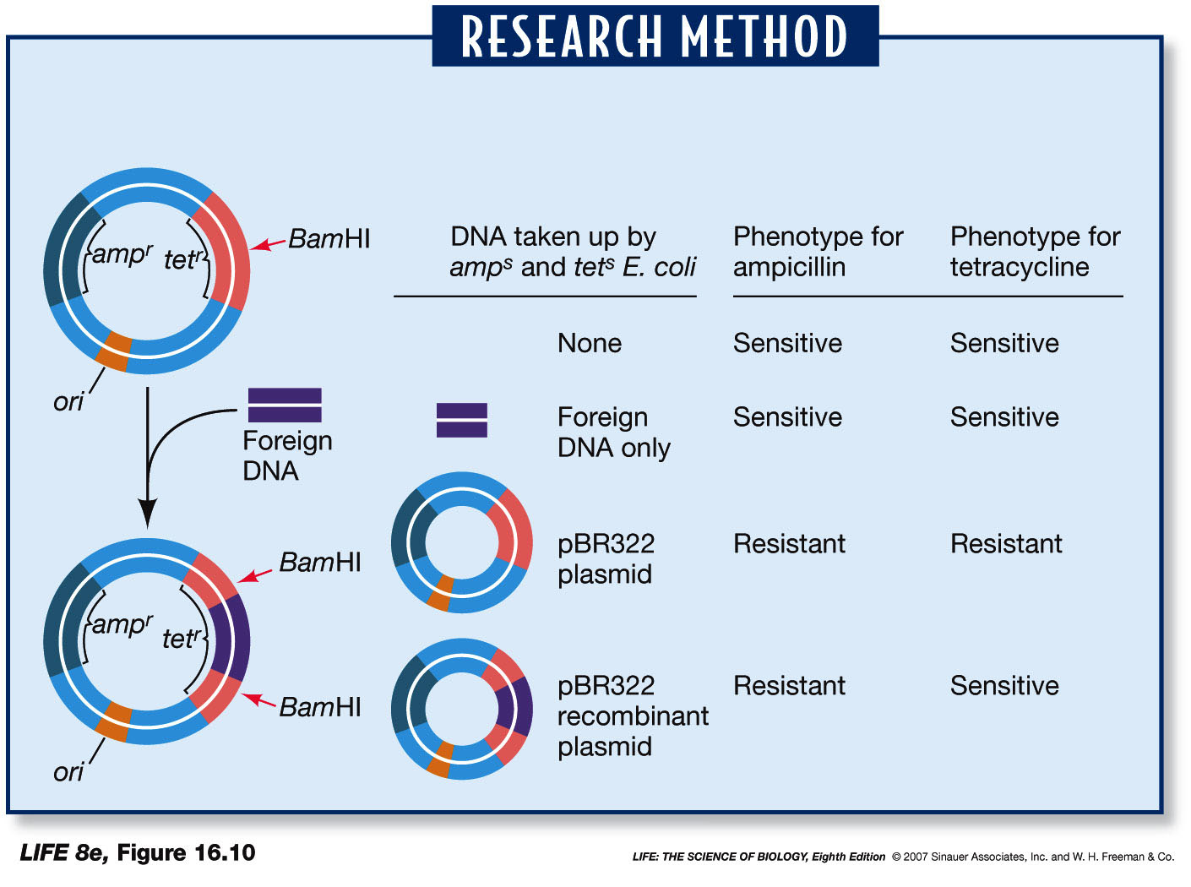
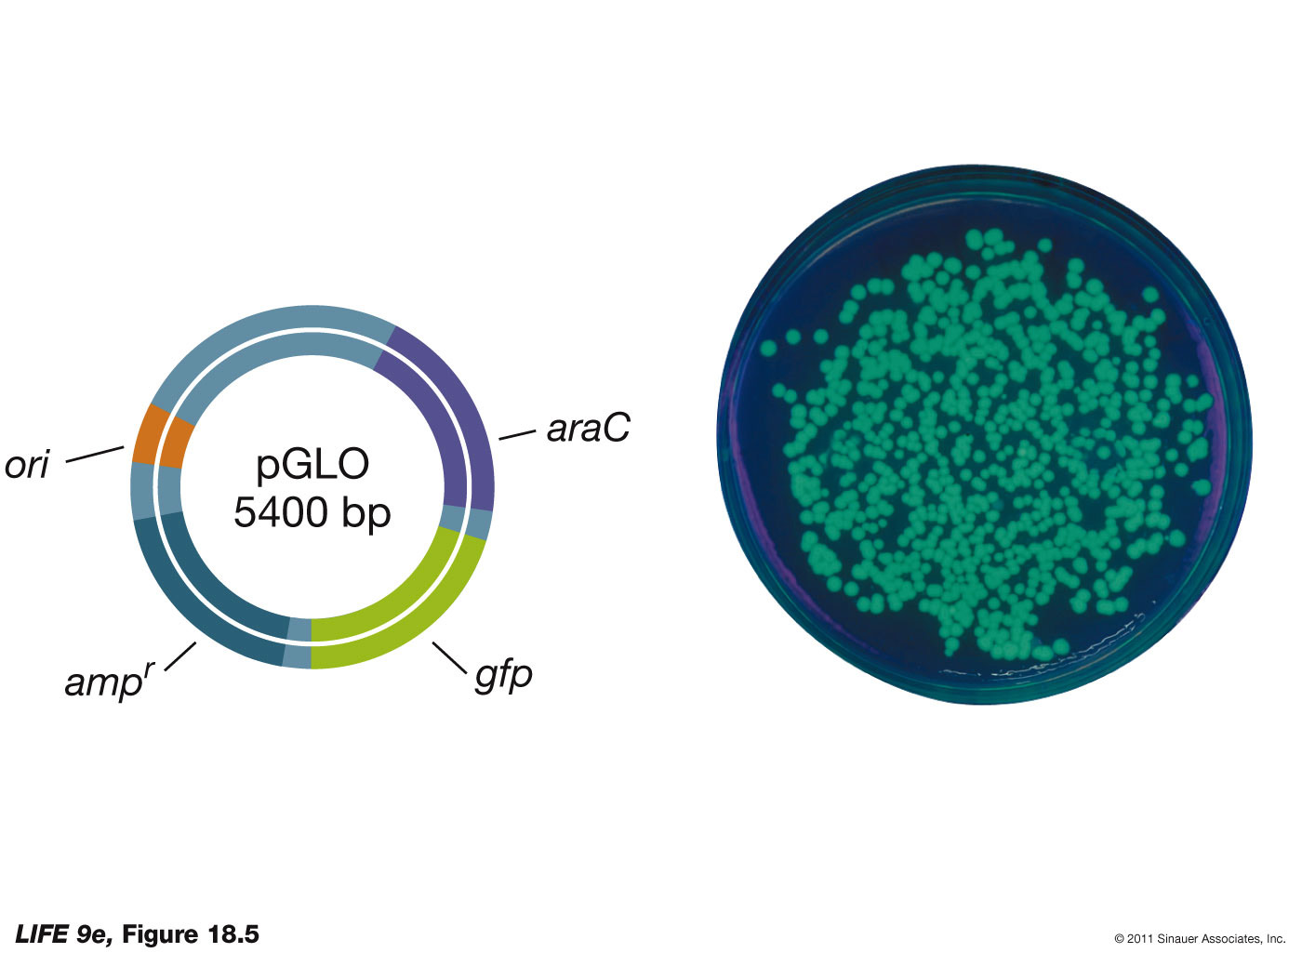
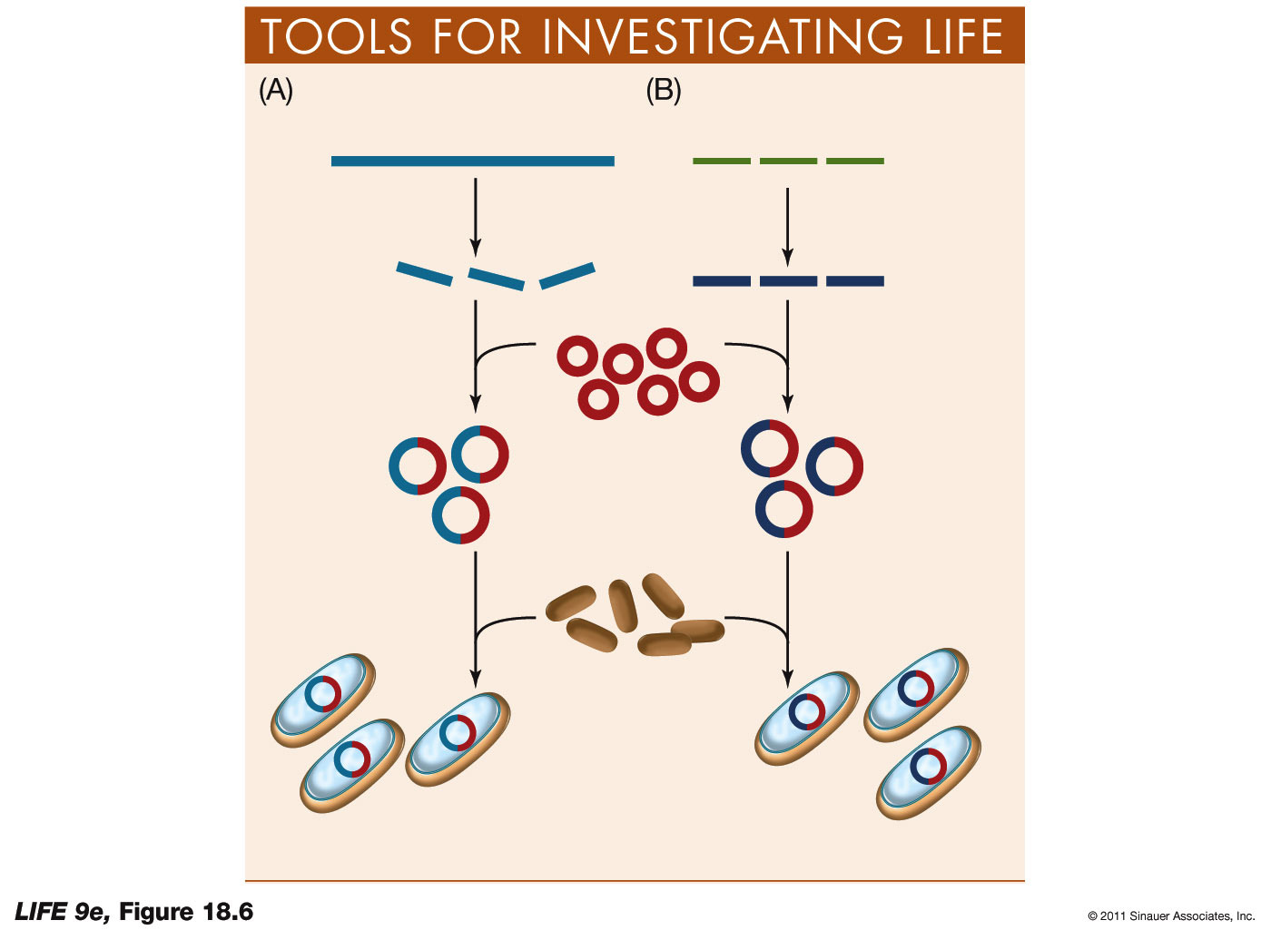
Intro to Biotech
Lect.9
Identifying recombinant plasmids
•
Useful Markers
•
•

Slide 6
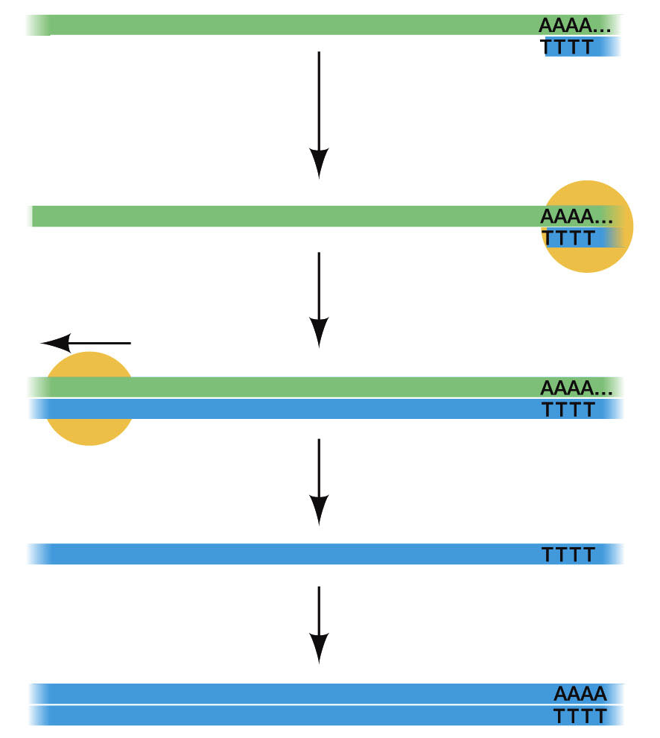
Intro to Biotech
Lect.9
Libraries
• isolate DNA
• mRNA (how do we isolate??)
1. location?
2. processing?
Genomic
cDNA
noncoding
what cells, tissue, organ, developmental stage?
how to clone
- digestion
- size/representation:
=
- stability
repetitive DNA
RNaseH
How identify gene of interest?
Are gene predictions accurate?

Slide 7
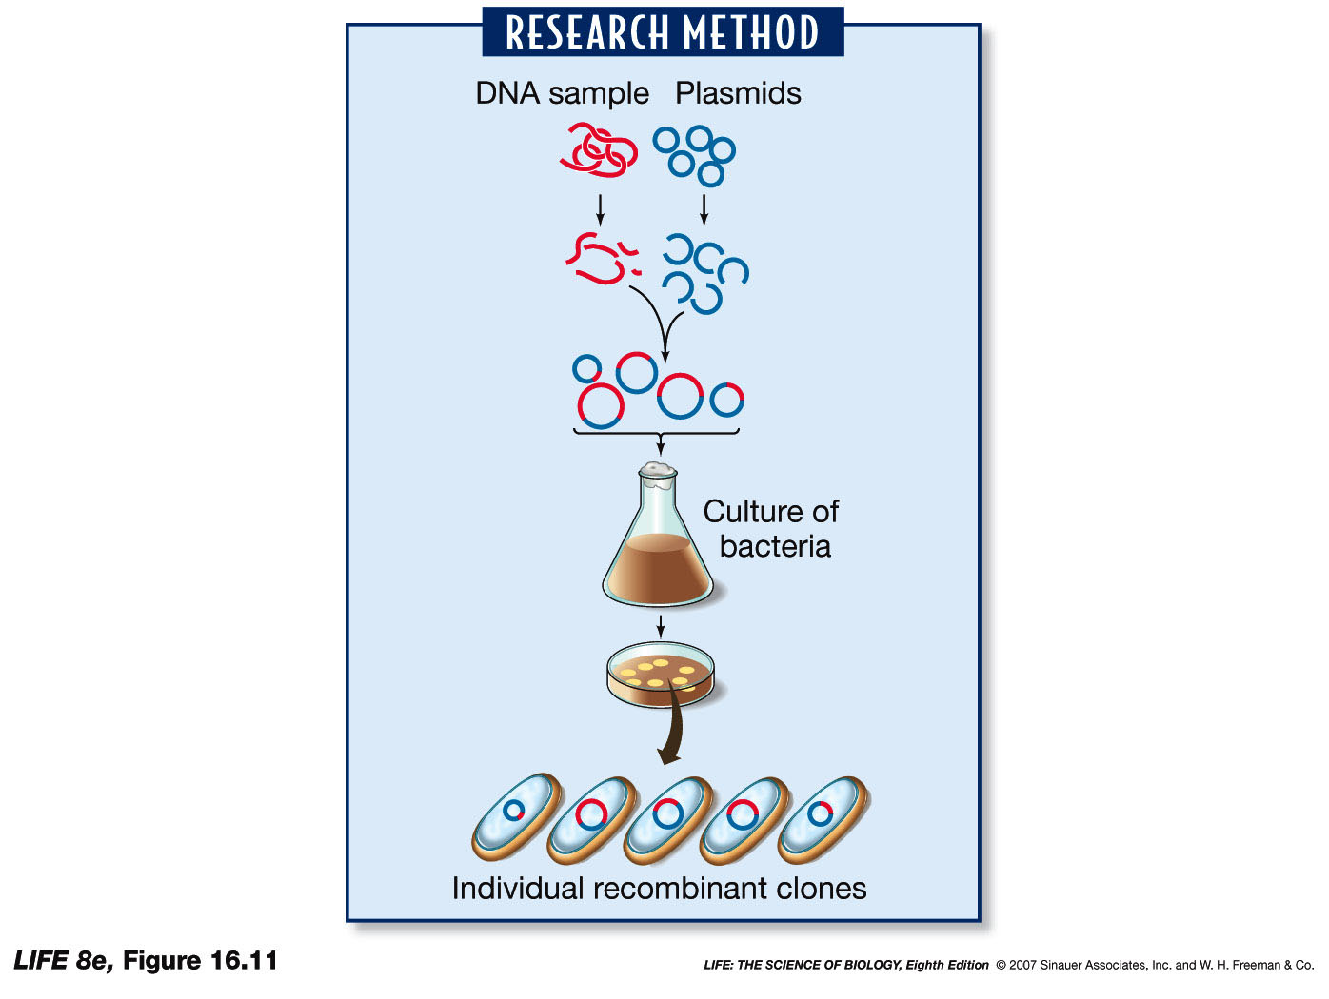
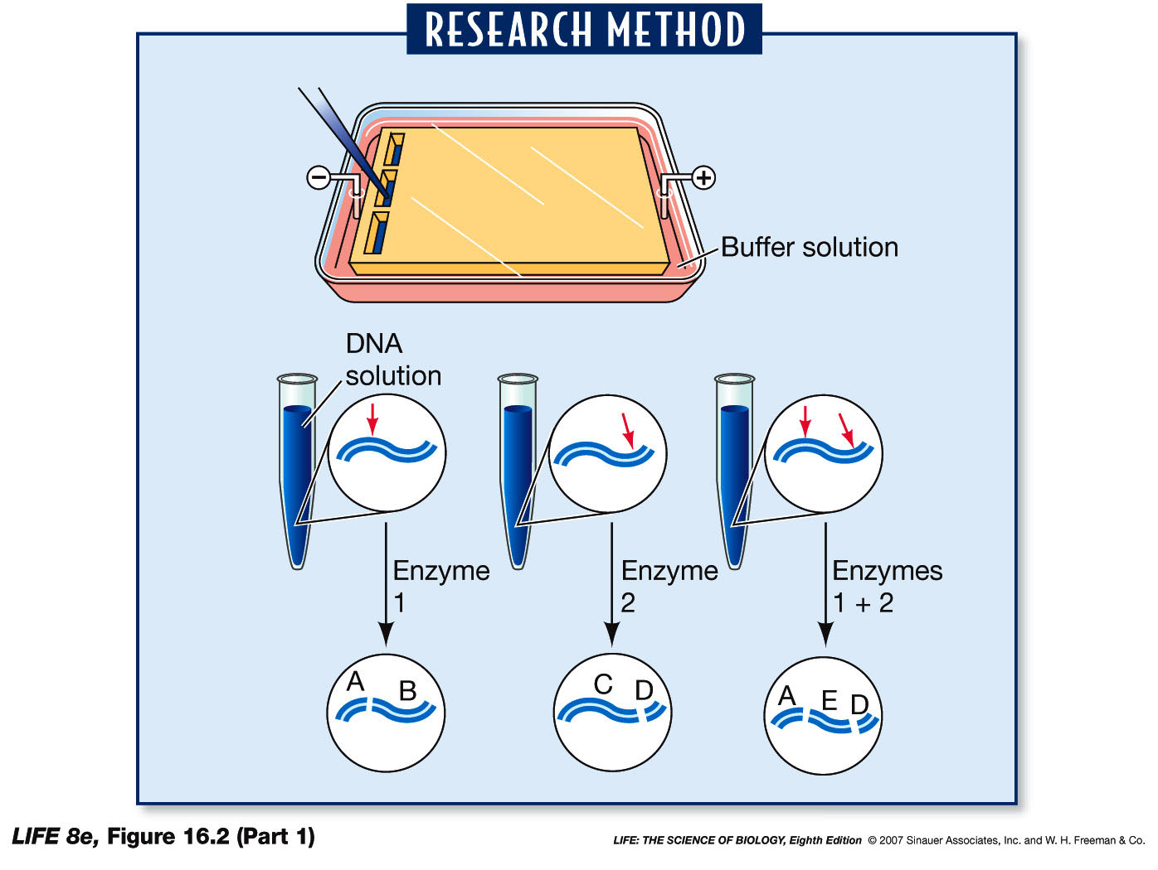
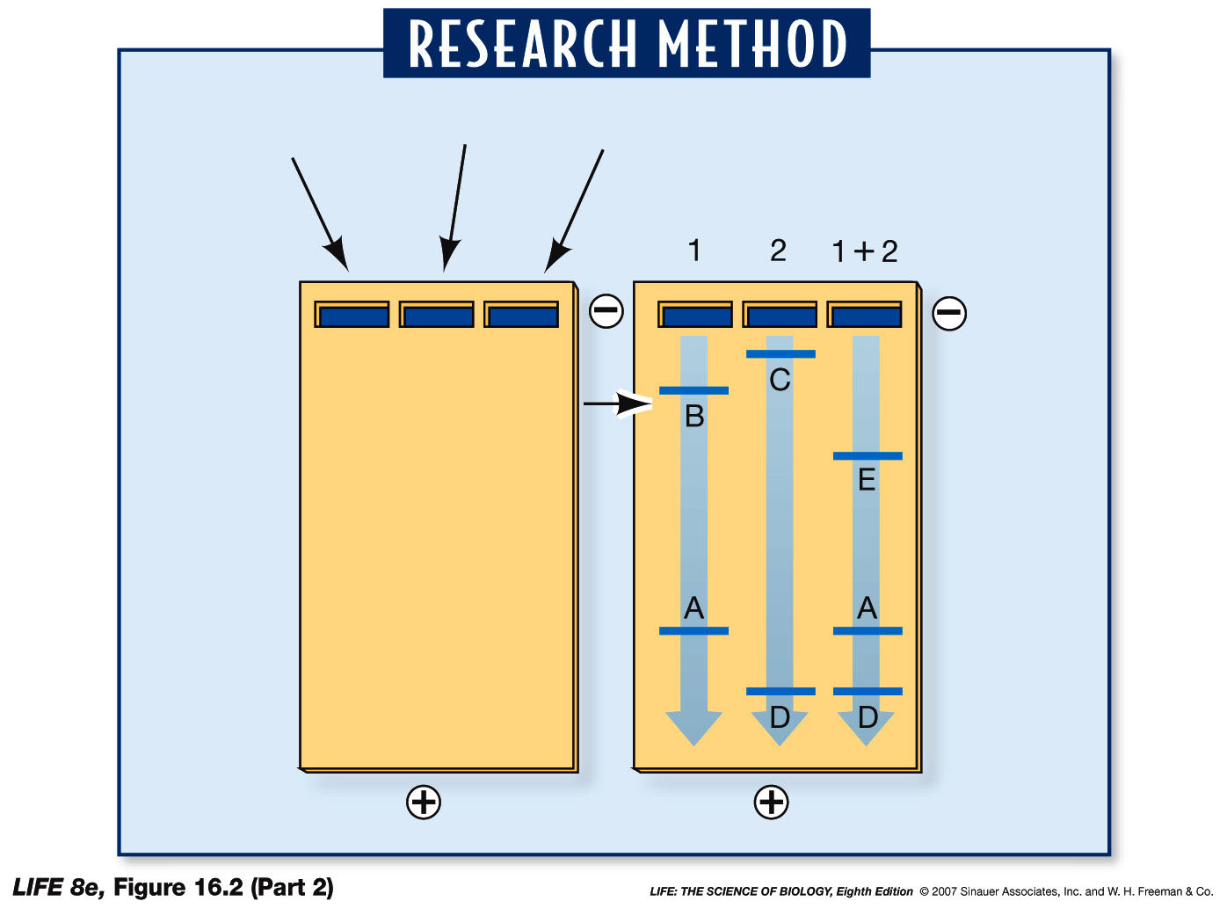
Intro to Biotech
Lect.9
Identifying recombinant plasmids
• characterize fragments
- gel electrophoresis
- restriction mapping
Identify correct plasmid

Slide 8
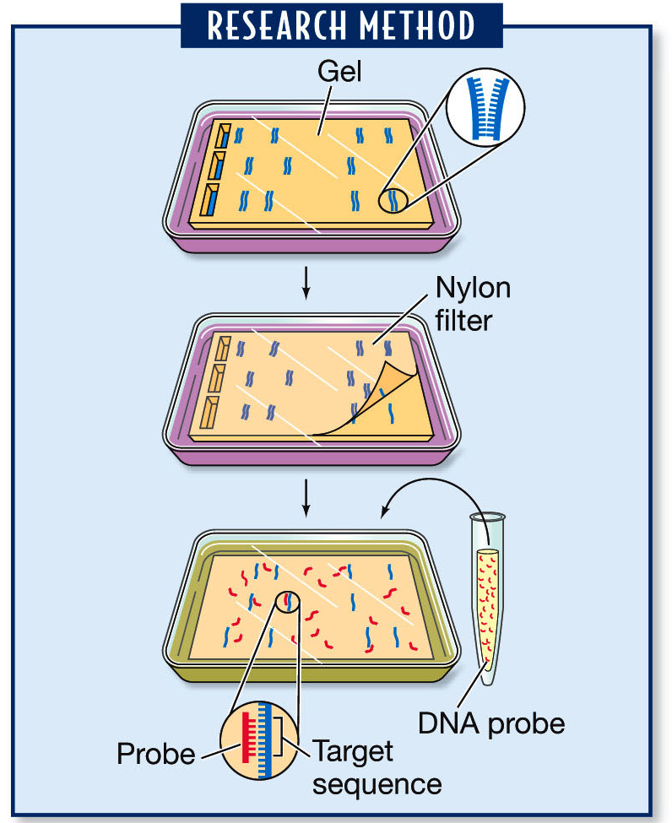
Intro to Biotech
Lect.9
Identifying recombinant plasmids
How do we identify DNA/RNA clone of interest??
Southern Blot
Northern Blot
- sequence analysis
Run DNA/RNA
Southern analysis:
RI
RI
RI
5kb 12.5kb
1
2
1
2
12.5kb
12.5kb
5kb

Slide 9
Intro to Biotech
Lect.9
How do we identify DNA/RNA clone
of interest??
Northerns:
- isolate
- electrophoresis
- transfer of mRNA to filter
- incubate w/ labeled DNA
- wash
- develop
Northern analysis:
probe
1
2
12.5kb
5kb

Slide 10
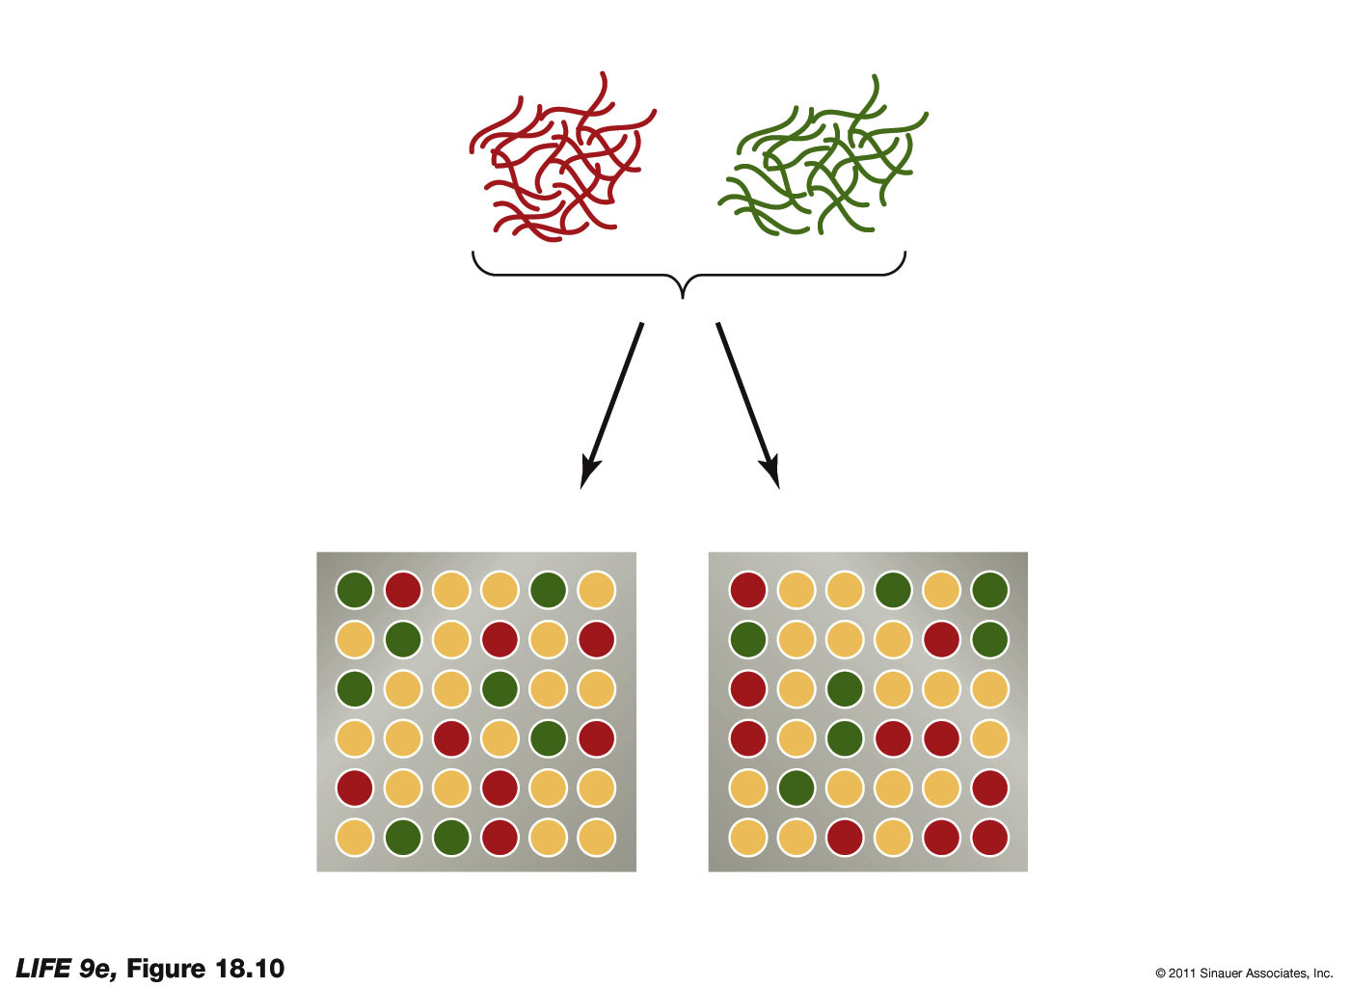
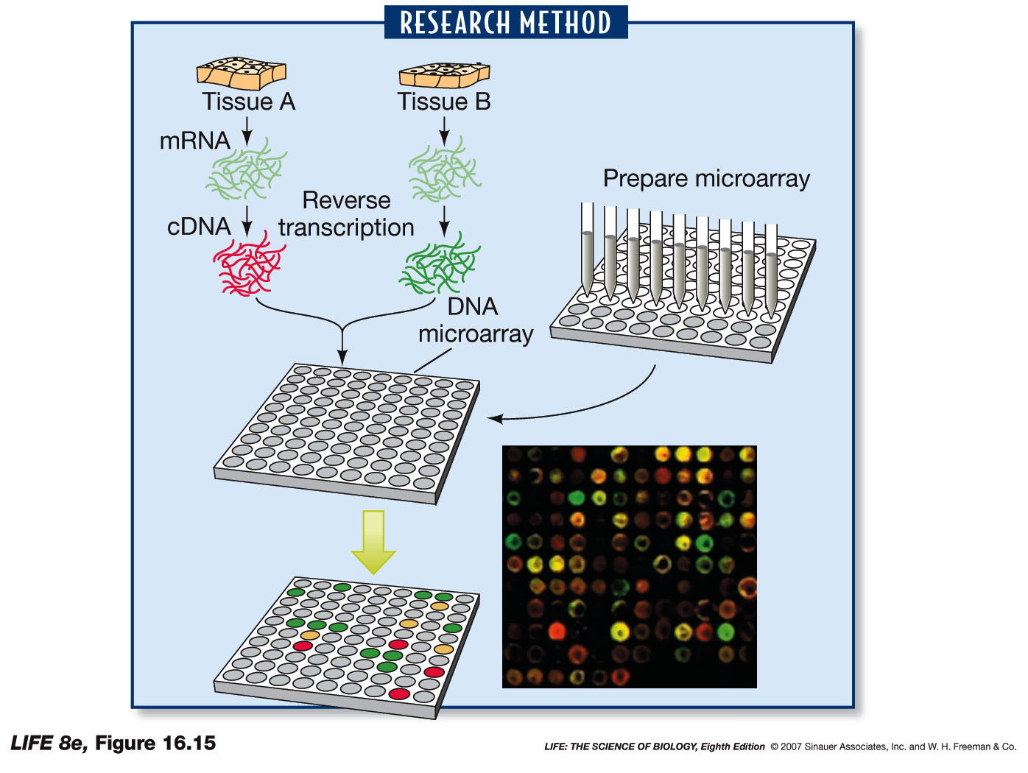
Intro to Biotech
Lect.9
DNA manipulation – hybridization…
Gene analysis on a global scale - microarrays
1. Array DNA sequences –
2. Isolate mRNA -
3. Label samples –
4. Hybridize to microarray
5. Detect fluorescent signals –

Slide 11
Intro to Biotech
Lect.9
Gene analysis on a global scale - microarrays
6. Uses ?
-

Slide 12
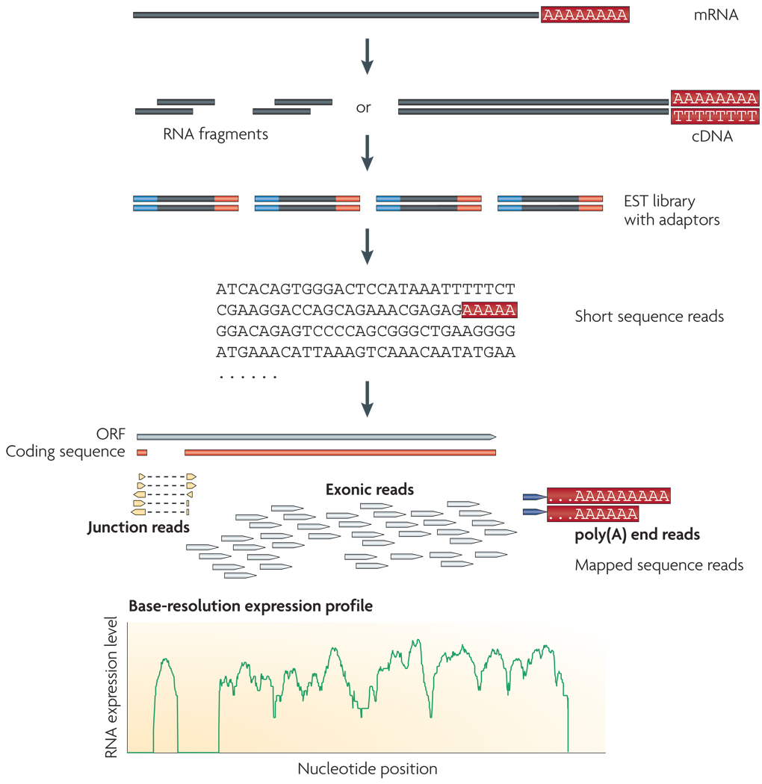
Intro to Biotech
Lect.9
Gene analysis on a global scale - RNA sequencing
6. Uses ?
-

